Slide 1

Module 2
Exploratory Data Analysis (EDA)
Notes:
Guidelines
Use section headers to chunk content in your presentation.
Use the same style of section header throughout your presentation.
Keep your title to no more than 2 lines.

Slide 2

EDA – Unstructured Data
Notes:
Guidelines
Use a title slide at the beginning of your presentation. There are 9 variations of title slides to choose from.
If you will have a series of slideshows, we recommend using the same style of title slide for each presentation.
Keep your title to no more than 2 lines.
Do not change the font style or font size of the title or subtitle.

Slide 3
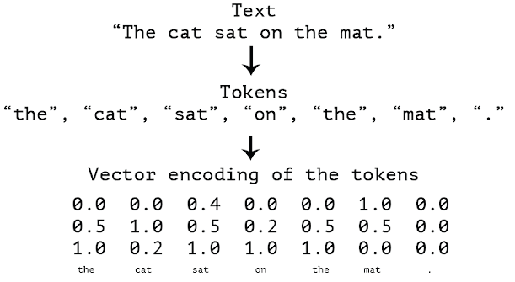
Text Data
We can encode text data into a vector representation
We call this vectorizing text
We convert the text into tokens (variables for our purpose)

Slide 4
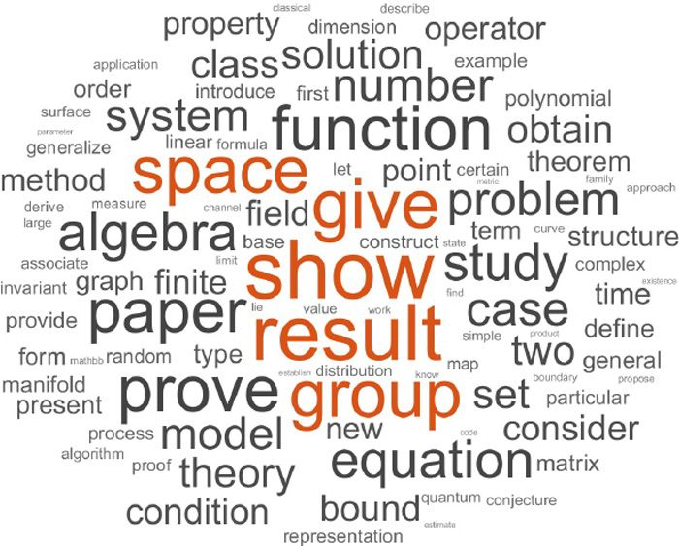
Text Data
Two of the main ways to vectorize text data are:
Bag of Words
Term Frequency

Slide 5
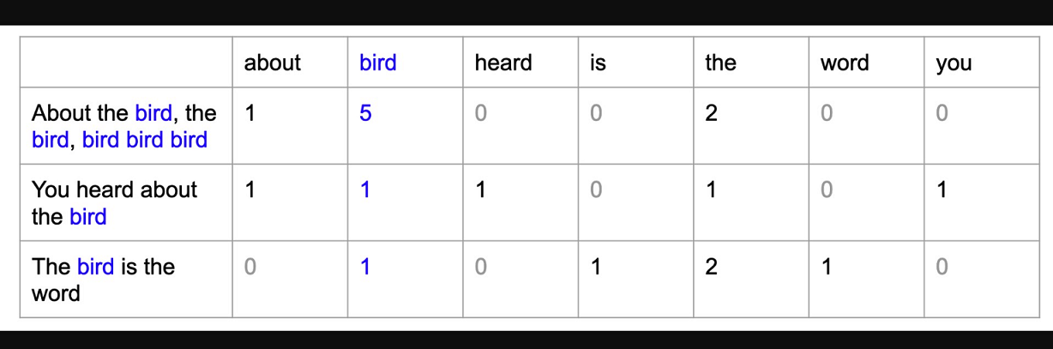
Bag of Words
We count the number of times a given word appears on the text.
We need to look at the corpus (all text) to determine all tokens

Slide 6
Python
Notes:
Guidelines
Use a title slide at the beginning of your presentation. There are 9 variations of title slides to choose from.
If you will have a series of slideshows, we recommend using the same style of title slide for each presentation.
Keep your title to no more than 2 lines.
Do not change the font style or font size of the title or subtitle.

Slide 7
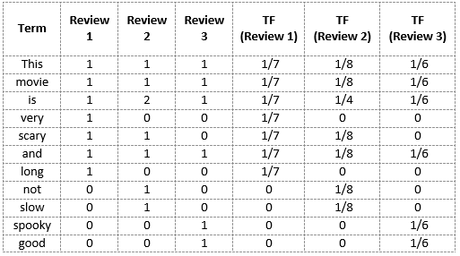
Term Frequency
We use the relative frequency of a word with respect to the document

Slide 8
Python
Notes:
Guidelines
Use a title slide at the beginning of your presentation. There are 9 variations of title slides to choose from.
If you will have a series of slideshows, we recommend using the same style of title slide for each presentation.
Keep your title to no more than 2 lines.
Do not change the font style or font size of the title or subtitle.

